Slide 1

2023/10/31
THE CHARACTERISTICS OF BRAZED PLATE HEAT EXCHANGERS WITH DIFFERENT CHEVRON ANGLES
JEONBUK NATIONAL UNIVERSITY
Class : Computational Thermal Engineering
Instructor : Mr. KUMARESH SELVAKUMAR
Student name : Huynh Tan Loc
Student ID : 202250710

Slide 2
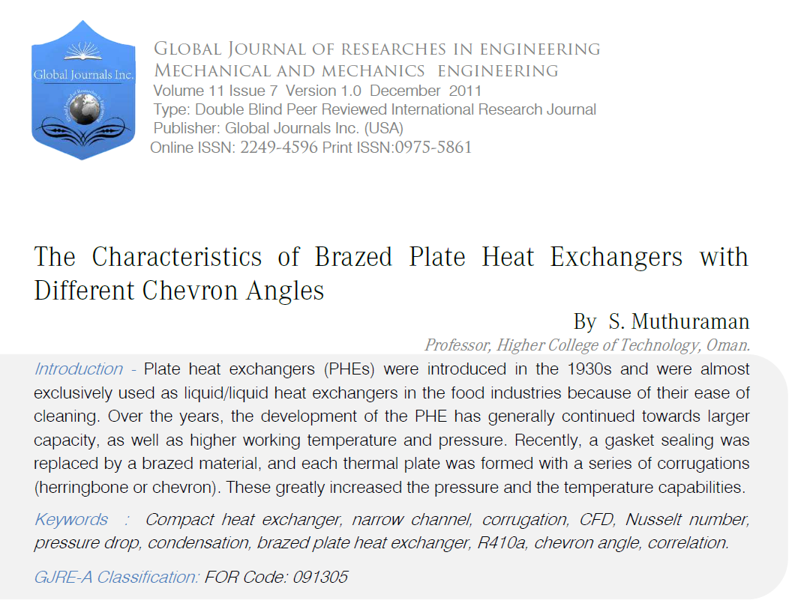

Slide 3
01
INTRODUCTION
JEONBUK NATIONAL UNIVERSITY

Slide 4
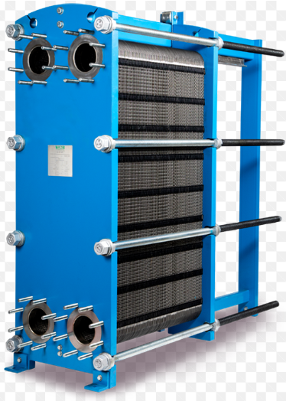
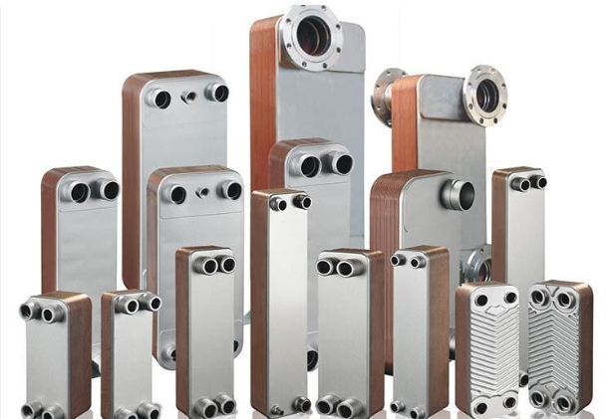

R410A
R32/R125
50%/50%
R22
The plate heat exchangers with gaskets (PHE)
The brazed plate heat exchangers (BPHE)
The 1930s
Later 1970s

Slide 5
Investigating the heat transfer coefficients and the pressure drops during condensation of R410A inside BPHEs.
Three BPHEs with different chevron angles of 45, 35, and 20 were used.
== R22
The geometric effects of the plate on the heat transfer and the pressure drop were investigated by varying the mass flux, the quality, and the condensation temperature.
Developing the correlations for the Nusselt number and the friction factor.

Slide 6

K-epsilon | K-omega
Overpredicts wall shear stress and heat flux in BPHEs. | More robust and does not require very fine grid near the wall.
Requires course grid near the wall. | Sensitive to free stream values of turbulence frequency.
SST is the most popular turbulence model for simulating BPHEs due to its robustness, accuracy, and low grid requirements.
BPHEs can be simulated using a modular approach, where the heat exchanger is divided into a large number of unit cells (REUs).
REUs can be simulated individually using periodic boundary conditions, which reduces the computational cost of simulating BPHEs.

Slide 7
This simple model, comprised of only one corrugated plate and a flat plate, was constructed and simulated.
The Reynolds numbers examined are 400, 900, 1000, 1150, 1250 and 1400.
The SST turbulence model was preferred over other flow models for the simulation.

Slide 8
02
EXPERIMENTAL SETUP
JEONBUK NATIONAL UNIVERSITY

Slide 9
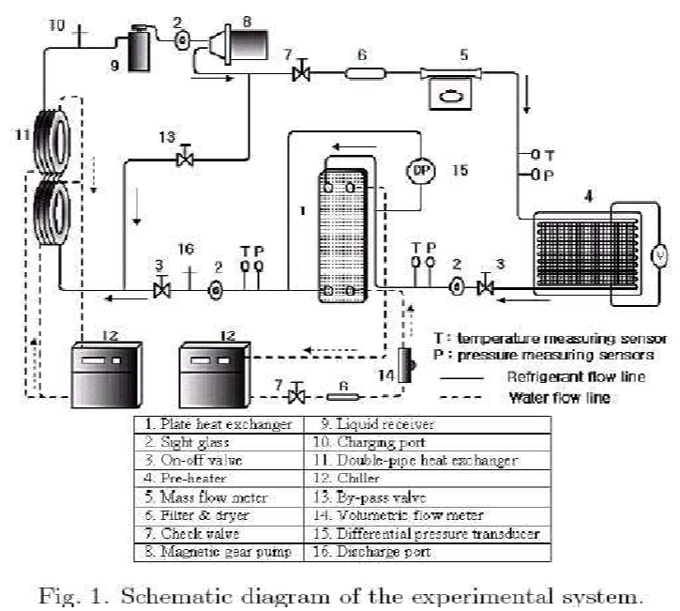
The experimental facility consists of four main parts:
Test section.
Refrigerant loop: The refrigerant loop circulates the refrigerant through the BPHE. The refrigerant loop includes a compressor, condenser, evaporator, and expansion valve.
Two water loops: The two water loops circulate water through the BPHE to provide a heat sink or heat source. The water loops include a pump, heater, and cooler.
Data-acquisition system.

Slide 10
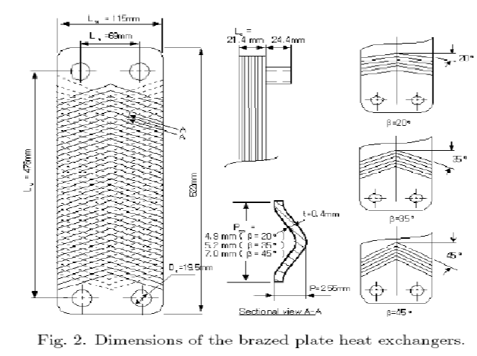
Brazed plate heat exchangers:
Each BPHE was composed of 4 thermal plates and 2 end plates, forming 5 flow channels

Slide 11
Heat transfer coefﬁcient

Slide 12
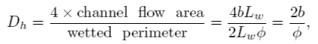
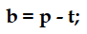
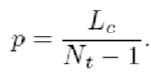
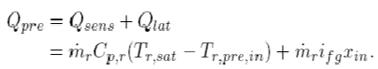
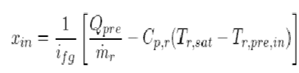
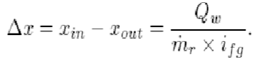
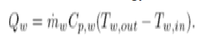
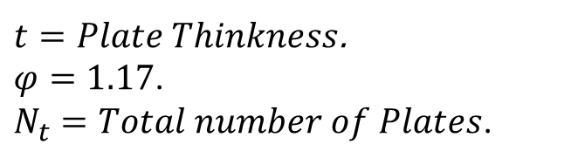
The hydraulic diameter of the channel:
The mean channel spacing:
The plate pitch:
The pre-heater heat:
The refrigerant quality at the inlet of the test section:
The change in the refrigerant quality inside the test section:
The condensing heat in the test section:
$t=Plate Thinkness$.
$φ=1.17$.
$N_{t}=Total number of Plates$.

Slide 13
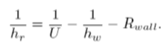
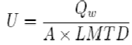
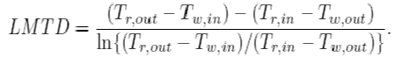
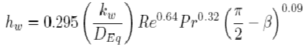
The heat transfer coefficient of the refrigerant side:
The overall heat transfer coefficient:
The heat transfer coefficient of the water side:

Slide 14
Frictional pressure drop

Slide 15
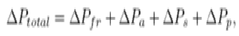
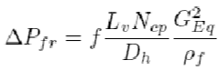
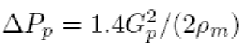
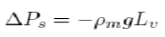
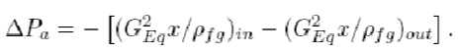
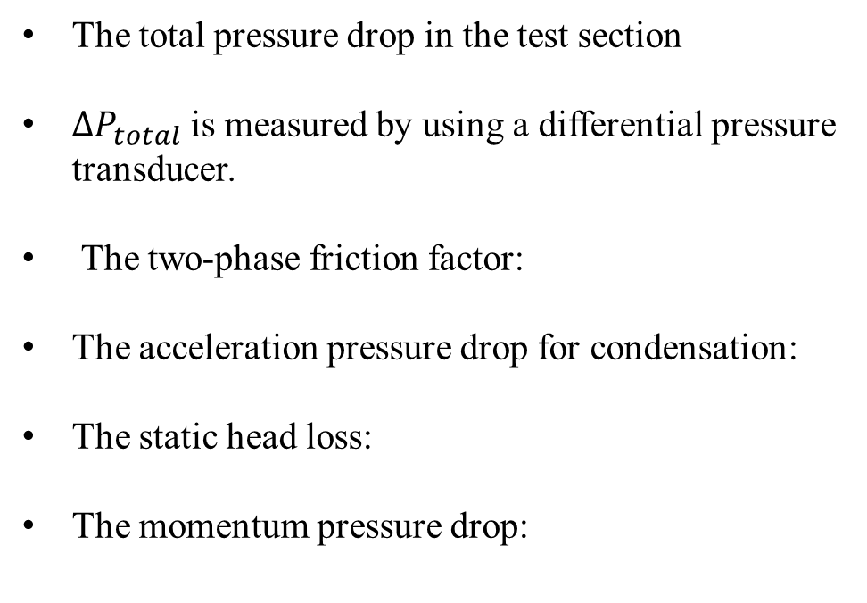
The total pressure drop in the test section
$∆P_{total}$ is measured by using a differential pressure transducer.
The two-phase friction factor:
The acceleration pressure drop for condensation:
The static head loss:
The momentum pressure drop:

Slide 16
03
RESULTS
JEONBUK NATIONAL UNIVERSITY

Slide 17
Experiment conditions:
The condensation heat transfer coefficients and the pressure drops of R410A and R22 were measured in
3 BPHEs with chevron angles of 20°, 35°, and 45°
The mass flux (13 - 34 kg/m2s)
The vapor quality (0.9 - 0.15)
The condensing temperature (20°C and 30°C) under a given heat flux condition (4.7 -5.3 kW/m2).

Slide 18
CONDENSATION HEAT TRANSFER

Slide 19
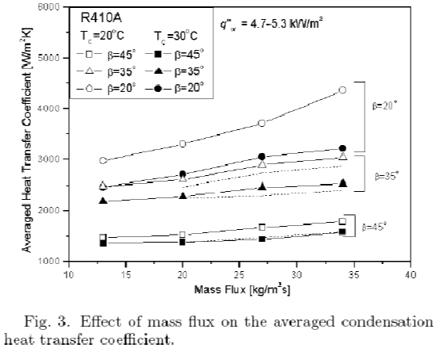
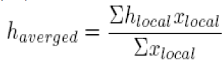

Fig. 3 shows the effects of the refrigerant mass flux, the chevron angle, and the condensation temperature on the averaged heat transfer coefficient for R410A.
The averaged heat transfer coefficient means the average of the heat transfer coefficients calculated by varying the quality of the refrigerant from 0.15 to 0.9.
The small chevron angle → narrow pitches → changes in the velocity and the flow direction → increasing the effective contact length and time in a BHPE → increases the heat transfer.
A PHE with a small chevron angle is more effective at a large mass flux ( $> 25 {kg}/{m^{2}s}$) than at a small mass flux

Slide 20
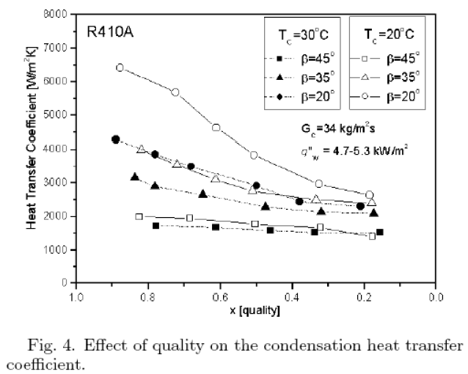
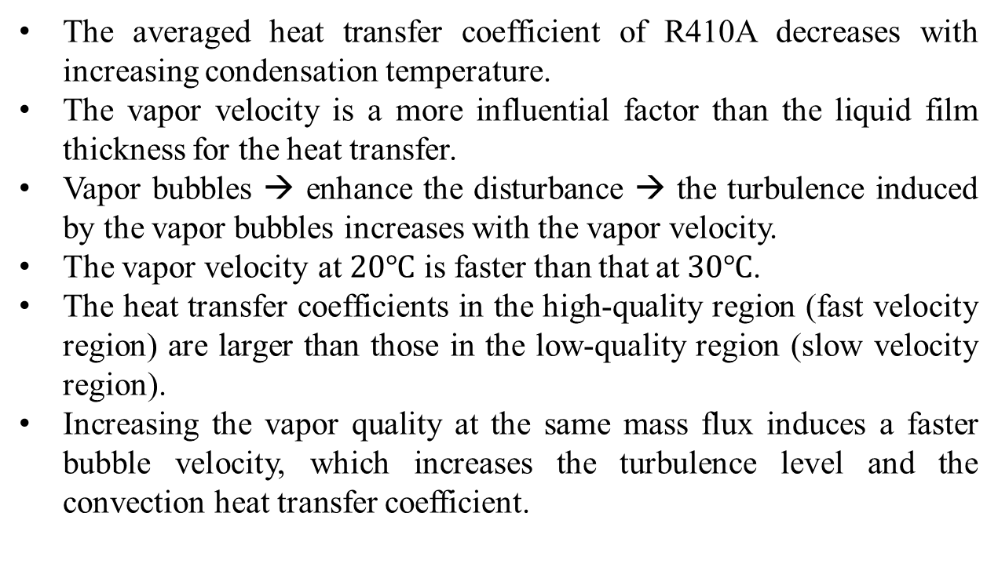
The averaged heat transfer coefficient of R410A decreases with increasing condensation temperature.
The vapor velocity is a more influential factor than the liquid film thickness for the heat transfer.
Vapor bubbles → enhance the disturbance → the turbulence induced by the vapor bubbles increases with the vapor velocity.
The vapor velocity at $20℃$ is faster than that at $30℃$.
The heat transfer coefficients in the high-quality region (fast velocity region) are larger than those in the low-quality region (slow velocity region).
Increasing the vapor quality at the same mass flux induces a faster bubble velocity, which increases the turbulence level and the convection heat transfer coefficient.
From the experimental results in Figures, 3 and 4, lowering the chevron angle and the condensation temperature gives the desired heat transfer effect.

Slide 21
FRICTIONAL PRESSURE LOSS

Slide 22
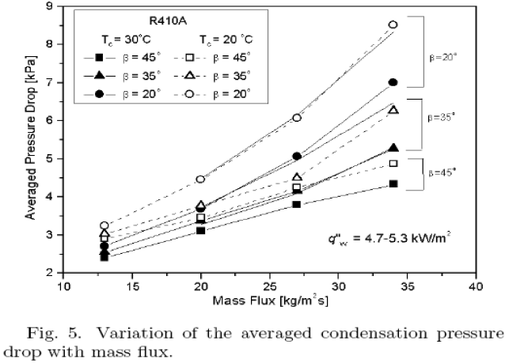
The frictional pressure drop in a BPHE increases with increasing mass flux, quality, and decreasing condensation temperature and chevron angle.
The vapor velocity is the dominant influence on both the pressure drop and the heat transfer in a BPHE.
The trends of the condensation heat transfer and the pressure drop in BPHEs are similar, so both effects must be carefully considered when designing a BPHE.

Slide 23
COMPARISON OF R410A WITH R22

Slide 24
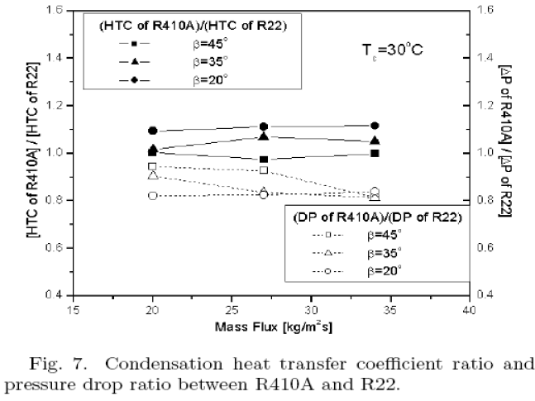
The smaller specific volume of the vapor of R410A relative to that of R22 makes the vapor velocity slower and yields a small pressure drop under the same conditions of the mass flux.
While the two fluids have almost equal values of their latent heats, the liquid-phase thermal conductivity of R410A is larger than that of R22.
The higher thermal conductivity for R410A helps to produce better heat transfer even if a reduction in the specific volume occurs.
Also, a BPHE with a small chevron angle is known to have more effective performance from the ratios when replacing R22 with R410A.

Slide 25
CORRELATIONS
OF
NUSSELT NUMBER AND FRICTION FACTOR FOR TESTED BPHES

Slide 26
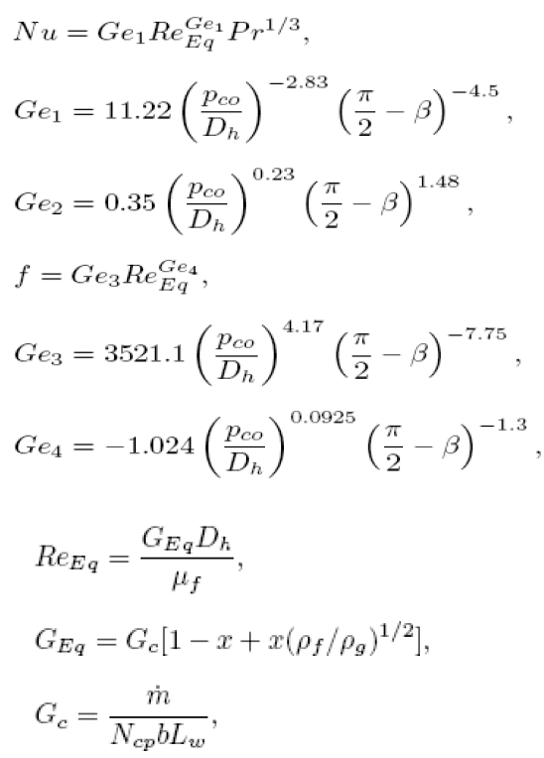
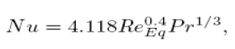
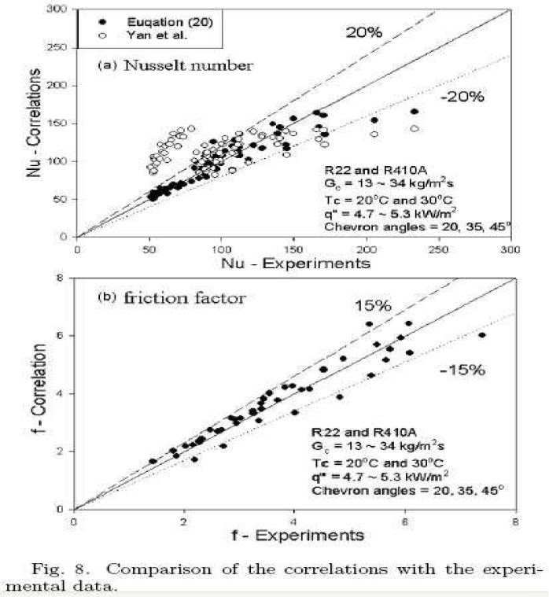
The correlations for Nu:

Slide 27
STUDY OF A SIMPLIFIED GEOMETRY

Slide 28
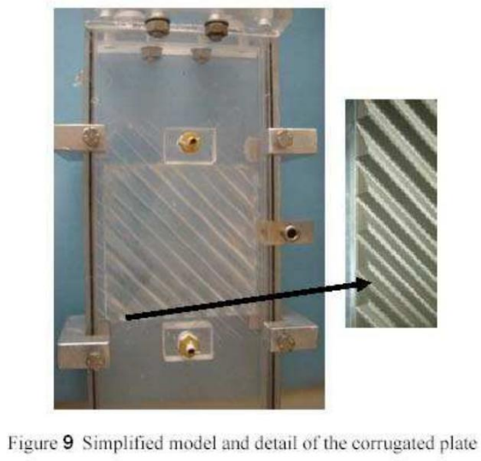
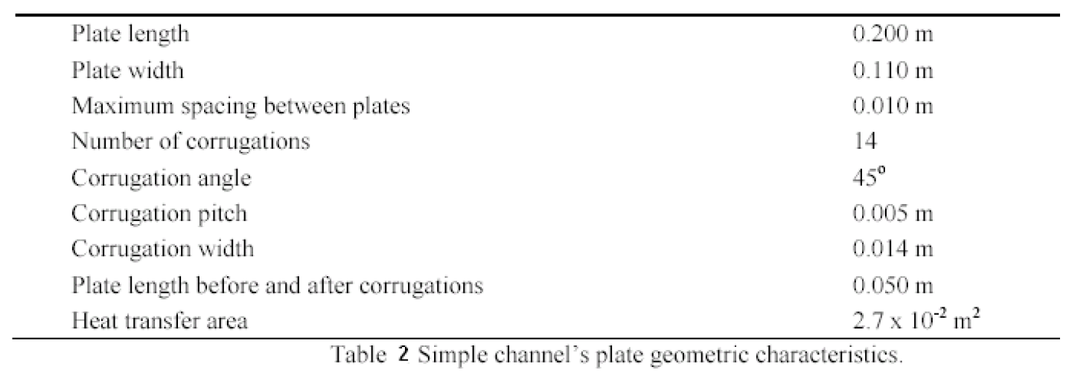
Consisting of only two plates:
The simple channel examined is a single pass made of Plexiglas (Figure 9).
It is formed by only one corrugated plate comprised of fourteen equal sized and uniformly spaced corrugations as well as a flat plate.

Slide 29
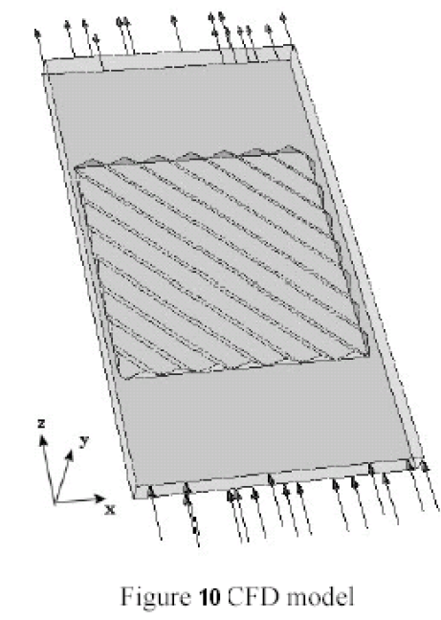
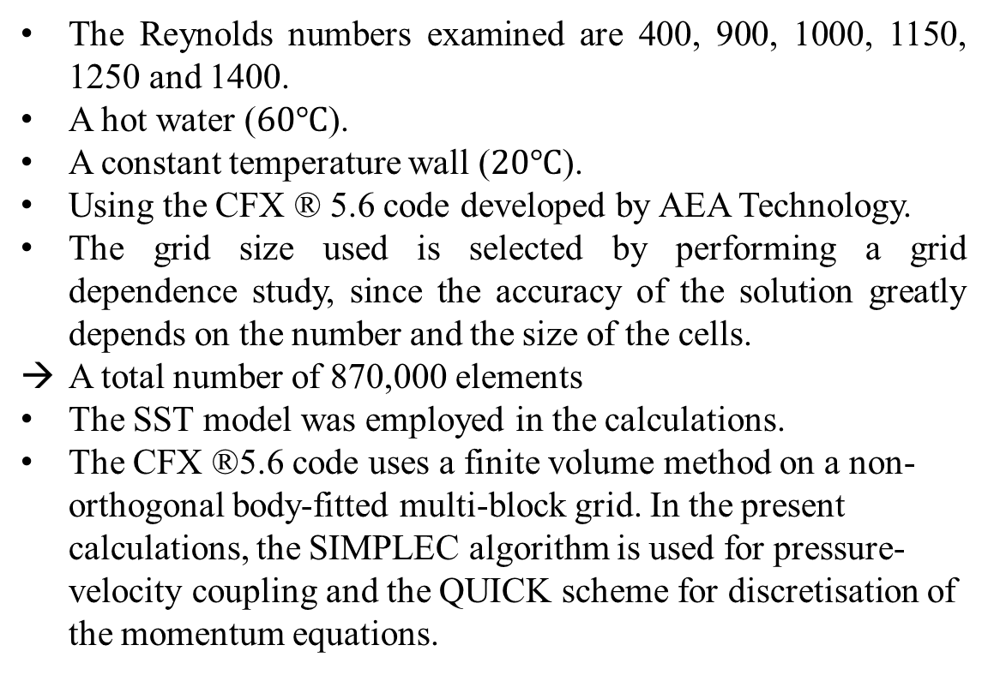
The Reynolds numbers examined are 400, 900, 1000, 1150, 1250 and 1400.
A hot water ($60℃$).
A constant temperature wall ($20℃$).
Using the CFX ® 5.6 code developed by AEA Technology.
The grid size used is selected by performing a grid dependence study, since the accuracy of the solution greatly depends on the number and the size of the cells.
A total number of 870,000 elements
The SST model was employed in the calculations.
The CFX ®5.6 code uses a finite volume method on a non-orthogonal body-fitted multi-block grid. In the present calculations, the SIMPLEC algorithm is used for pressure-velocity coupling and the QUICK scheme for discretisation of the momentum equations.

Slide 30
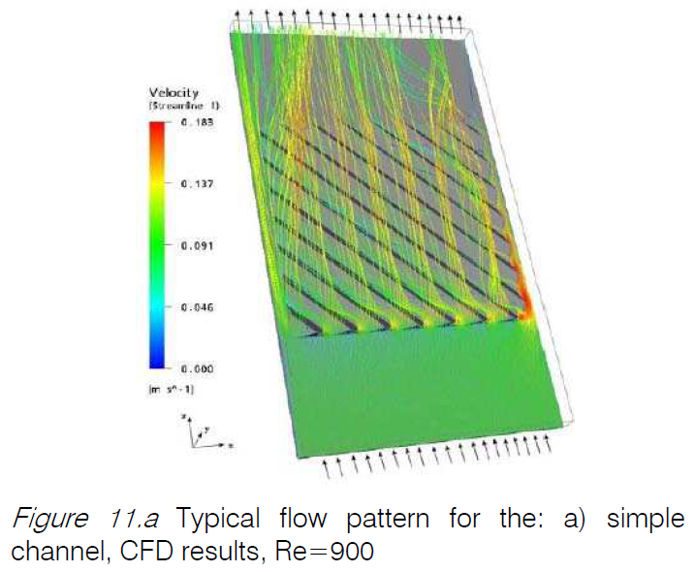
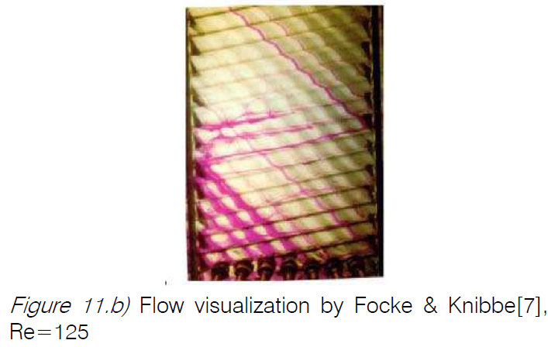
The results of the present study suggest that fluid flow is mainly directed inside the furrows and follows them.
The fluid, after entering a furrow, mostly follows it until it reaches the side wall, where it is reflected and enters the anti-symmetrical furrow of the plate above, a behavior similar to the one predicted by the CFD simulation.
It seems that, in both cases, most of the flow passes through the furrows, where enhanced heat transfer characteristics are expected.

Slide 31
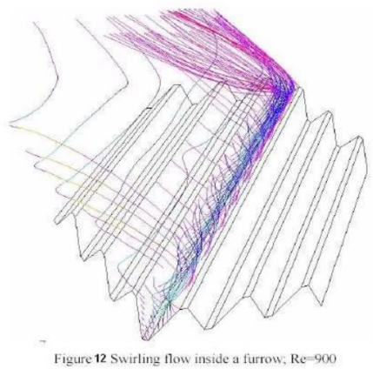
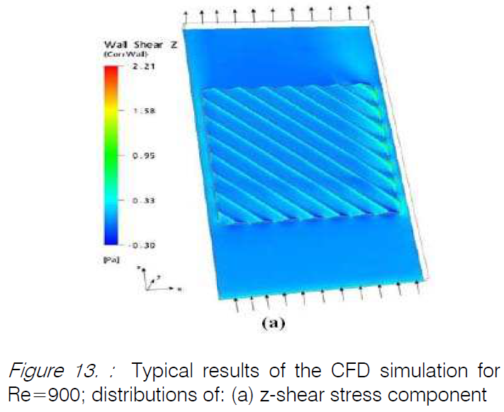
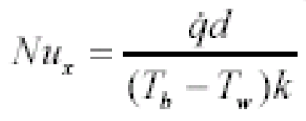
Figure 12 shows details of the flow inside a furrow for the simple model, where swirling flow is identified.
The values of the z-component of shear stress (Figure13a) increase with the Reynolds number –as expected–and the maximum value occurs at the crests of the corrugations.
The shear stress distribution tends to prevent the liquid layer from falling over the crest of the corrugations and to keep it inside the furrows
The local Nusselt number was calculated using the expression:

Slide 32
The shear stress distribution tends to prevent the liquid layer from falling over the crest of the corrugations and to keep it inside the furrows

Slide 33
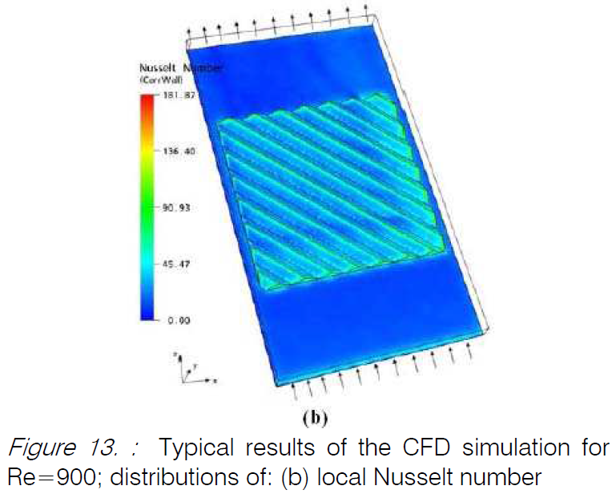
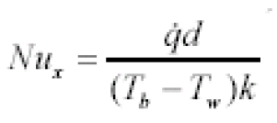
The local Nusselt number
A mean Nu – numerical integration of the local Nu only on the corrugated only.
An overall average Nu – using the total wall heat flux through the whole plate and the fluid temperatures at the channel entrance/exit.
The smooth part of the corrugated plate does not seem to influence the overall heat transfer.
It is noticeable that local Nusselt numbers attain their maximum value at the top of the corrugations. This confirms the strong effect of the corrugations, not only on the flow distribution, but also on the heat transfer rate.

Slide 34
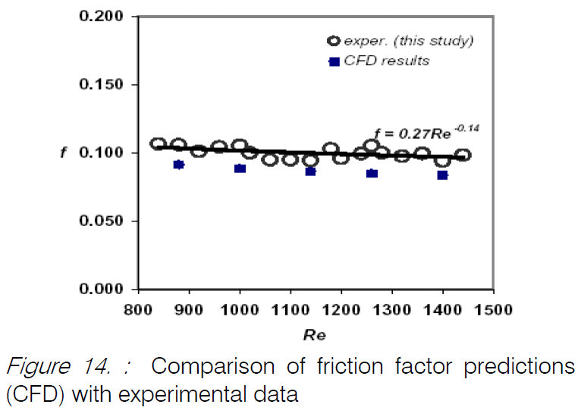
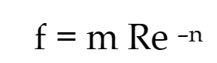
Figure 14 presents the experimental friction factors, obtained from the Plexiglas test section of Figure 9, as well as the CFD predictions for the simple geometry studied, as a function of the Reynolds number.
Where m and n constants with values 0.27 and 0.14 respectively.
In spite of the differences in geometry, it appears that the present results are in good agreement with the experimental data of Heavner et al.[14] (0.687 and 0.141 for the variables m and n, respectively).

Slide 35
04
CONCLUSION
JEONBUK NATIONAL UNIVERSITY

Slide 36
Both the heat transfer coefficient and the pressure drop increased proportionally with the mass flux and the vapor quality and inversely with the condensation temperature and the chevron angle. Those effects must be carefully considered in the design of a BPHE due their opposing effects.
A comparison of the data for R410A and R22 showed that the heat transfer coefficient for R410A was about larger and the pressure drop lower than those for R22. Therefore, R410A is a suitable alternative refrigerant for R22.
Correlations for the Nusselt number and the friction factor with the geometric parameters were suggested for the tested BPHEs.
Although compact heat exchangers with corrugated plates offer many advantages compared to conventional heat exchangers, their main drawback is the absence of a general design method.
CFD simulation is a promising tool for the design of compact heat exchangers, as it allows for the investigation of various geometries and the effect of various design configurations on heat transfer and flow characteristics.
The results of the simulations were consistent with the experimental data and showed that the corrugations have a significant impact on both the flow distribution and the heat transfer rate.

Slide 37
감사합니다
THANK YOU
CẢM ƠN
JEONBUK NATIONAL UNIVERSITY

